Slide 1
Security
Charles Severance

Slide 2
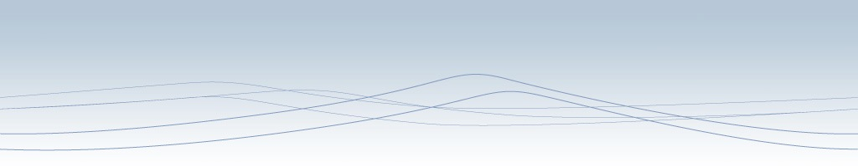



Unless otherwise noted, the content of these slides are licensed under a Creative Commons Attribution 3.0 License.
http://creativecommons.org/licenses/by/3.0/.
Copyright 2009- Charles Severance.
You assume all responsibility for use and potential liability associated with any use of the material. Material contains copyrighted content, used in accordance with U.S. law. Copyright holders of content included in this material should contact open.michigan@umich.edu with any questions, corrections, or clarifications regarding the use of content. The Regents of the University of Michigan do not license the use of third party content posted to this site unless such a license is specifically granted in connection with particular content. Users of content are responsible for their compliance with applicable law. Mention of specific products in this material solely represents the opinion of the speaker and does not represent an endorsement by the University of Michigan. For more information about how to cite these materials visit http://michigan.educommons.net/about/terms-of-use.
Any medical information in this material is intended to inform and educate and is not a tool for self-diagnosis or a replacement for medical evaluation, advice, diagnosis or treatment by a healthcare professional. You should speak to your physician or make an appointment to be seen if you have questions or concerns about this information or your medical condition. Viewer discretion is advised: Material may contain medical images that may be disturbing to some viewers.

Slide 3
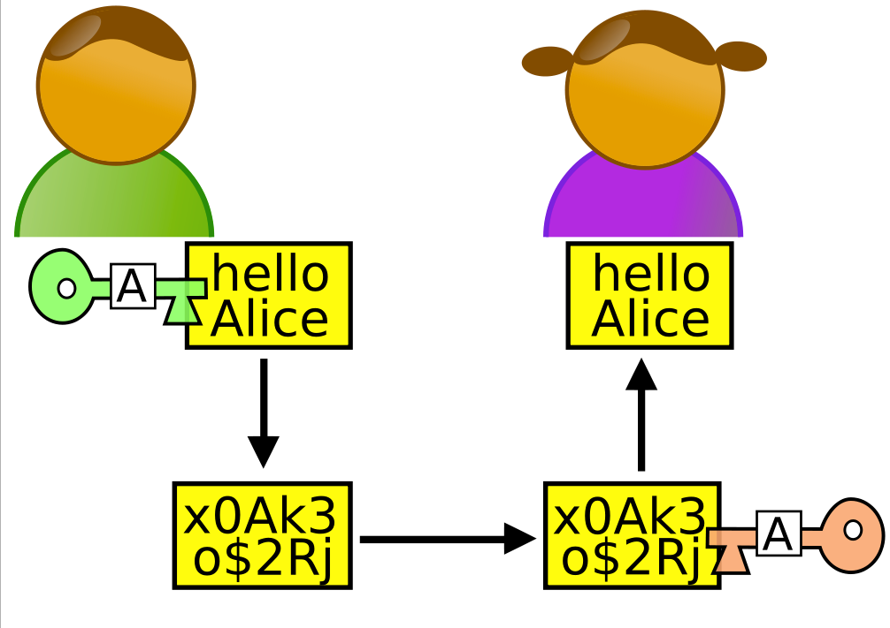
Lets Meet some Nice People
http://en.wikipedia.org/wiki/Alice_and_Bob

Slide 4
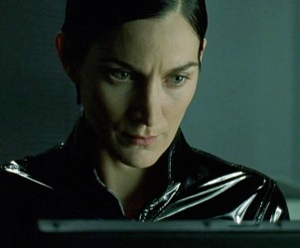
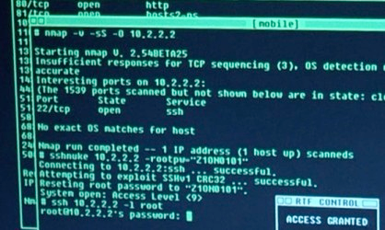
People With Bad Intent
Carol, Carlos or Charlie, as a third participant in communications.
Chuck, as a third participant usually of malicious intent
Dan or Dave, a fourth participant,
Eve, an eavesdropper, is usually a passive attacker. While she can listen in on messages between Alice and Bob, she cannot modify them.
.......
http://en.wikipedia.org/wiki/Alice_and_Bob

Slide 5
Paranoia
Who is out to get you?
If you are interesting or influential people want to get into your personal info.
If you are normal, folks want to use your resources or take your information to make money…
Usually no one cares… But it is safest to assume some is always trying…

Slide 6
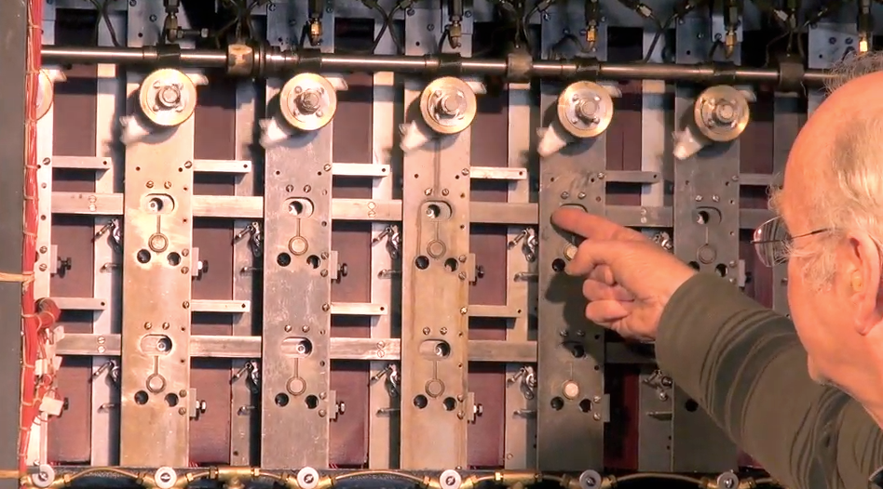
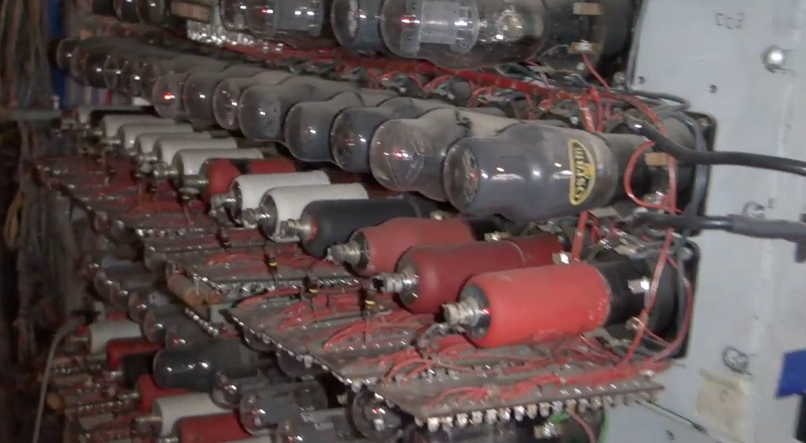
Alan Turing and Bletchley Park
Top secret code breaking effort
10,000 people at the peak (team effort)
BOMBE: Mechanical Computer
Colossus: Electronic Computer
http://www.youtube.com/watch?v=5nK_ft0Lf1s

Slide 7
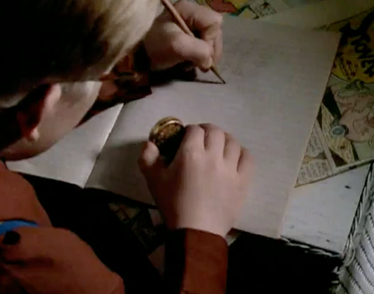
http://en.wikipedia.org/wiki/Bombe

Slide 8
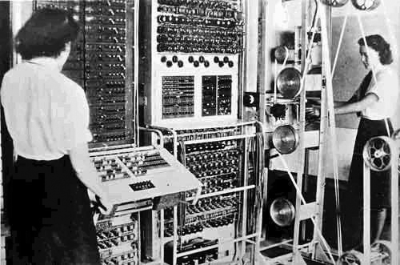
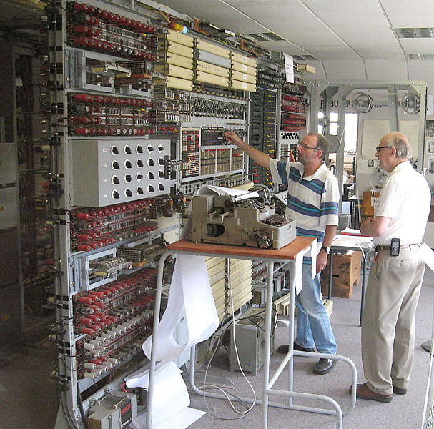
http://en.wikipedia.org/wiki/Colossus_computer
http://en.wikipedia.org/wiki/Tony_Sale

Slide 9
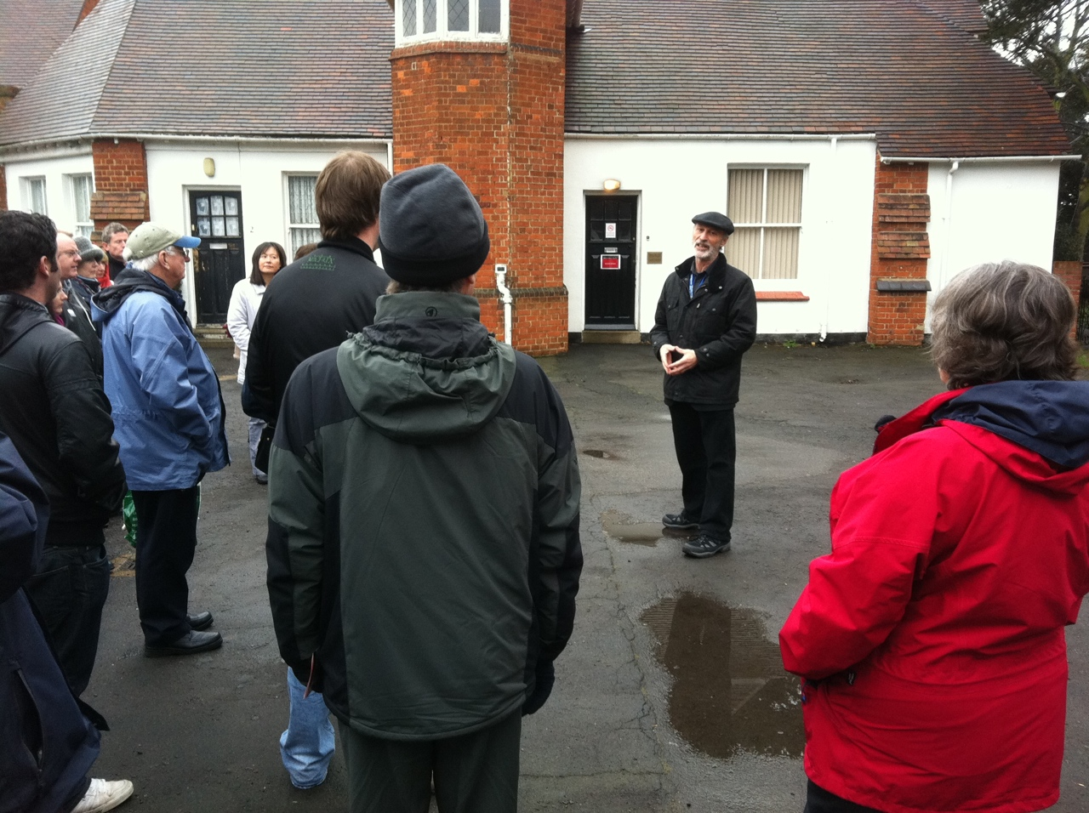
http://nmap.org/movies.html

Slide 10
Security is always a Tradeoff
"Perfect security" is unachievable - Must find the right tradeoff
Security .versus. Cost
Security .versus. Convenience (See also, "profit")
"More" is not always better – vendors of products will try to convince you that you *cannot live* without their particular gadget

Slide 11

Terminology
Confidentiality
Prevent unauthorized viewing of private information
Integrity
Information is from who you think it is from and has not been modified since it was sent

Slide 12
Ensuring Confidentiality
Encryption and Decryption

Slide 13
Terminology
Plaintext is a message that will be put into secret form.
Ciphertext is a transformed version of plaintext that is unintelligible to anyone without the means to decrypt

Slide 14
Terminology
The transformation of plaintext to ciphertext is referred to as encryption.
Returning the ciphertext back to plaintext is referred to as decryption.
The strength of a cryptosystem is determined by the encryption and decryption techniques and the length of the key.

Slide 15
Two Kinds of Systems
Two basic types of cryptosystems exist, secret-key and public-key.
In a secret-key scheme, the key used for encryption must be the same key used for decryption. Also called symmetric-key cryptosystem.
Secret-key cryptosystems have the problem of secure key distribution to all parties using the cryptosystem.

Slide 16

Plaintext:
"candy"
c = d
a = b
n = o
d = e
y = z
Plaintext:
"candy"
Encrypt
Decrypt
CipherText:
"dboez"
CipherText:
"dboez"
Message Might be Intercepted
Alice
Eve
Bob

Slide 17
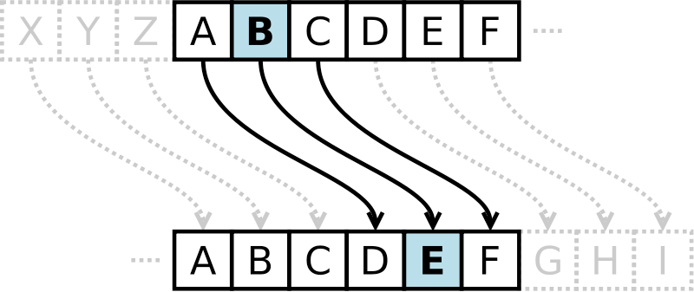
Caesar Cipher
Shift of 3
Caesar cipher is one of the simplest and most widely known encryption techniques. It is a type of substitution cipher in which each letter in the plaintext is replaced by a letter some fixed number of positions down the alphabet.
http://en.wikipedia.org/wiki/Caesar_cipher

Slide 18
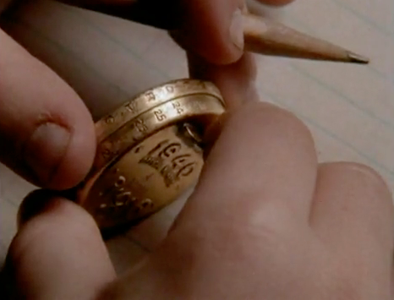
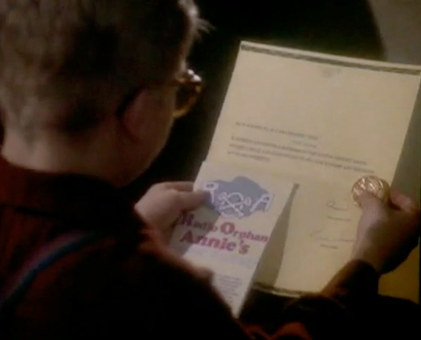
Secret Decoder Ring
http://www.youtube.com/watch?v=zdA__2tKoIU

Slide 19
Secret Decoder Ring - Shift Number
PP: A B C D E F G H I J K L M N O P Q R S T U V W X Y Z
01: B C D E F G H I J K L M N O P Q R S T U V W X Y Z A
02: C D E F G H I J K L M N O P Q R S T U V W X Y Z A B
08: I J K L M N O P Q R S T U V W X Y Z A B C D E F G H
09: J K L M N O P Q R S T U V W X Y Z A B C D E F G H I
10: K L M N O P Q R S T U V W X Y Z A B C D E F G H I J
11: L M N O P Q R S T U V W X Y Z A B C D E F G H I J K
12: M N O P Q R S T U V W X Y Z A B C D E F G H I J K L
13: N O P Q R S T U V W X Y Z A B C D E F G H I J K L M
14: O P Q R S T U V W X Y Z A B C D E F G H I J K L M N
http://www.dr-chuck.com/Secret-Decoder.pdf

Slide 20
Break the Code I
CipherText:
"upbtu"
For each number 1..26, see if when you decrypt the message using that shift, it makes sense.

Slide 21
Break the Code I
CipherText:
"upbtu"
Plaintext:
"toast"
00: A B C D E F G H I J K L M N O P Q R S T U V W X Y Z
01: B C D E F G H I J K L M N O P Q R S T U V W X Y Z A
A shift of 1

Slide 22
Break the Code II
Uryyb, zl anzr vf Puhpx naq V arrq zbarl naq n wrg.

Slide 23
Break the Code II
Uryyb, zl anzr vf Puhpx naq V arrq zbarl naq n wrg.
Hello, my name is Chuck and I need money and a jet.
www.rot13.com

Slide 24
Cryptographic Hashes
Integrity

Slide 25
Terminology
Confidentiality
Prevent unauthorized viewing of private information
Integrity
Information is from who you think it is from and has not been modified since it was sent

Slide 26
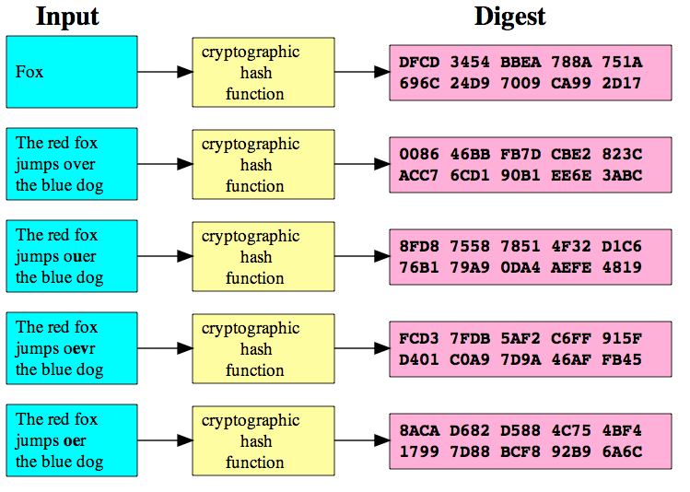
Cryptographic Hash
A cryptographic hash function is a function that takes an arbitrary block of data and returns a fixed-size bit string, the (cryptographic) hash value, such that an accidental or intentional change to the data will change the hash value. The data to be encoded is often called the "message," and the hash value is sometimes called the message digest or simply digest.
http://en.wikipedia.org/wiki/Cryptographic_hash_function

Slide 27
http://en.wikipedia.org/wiki/Cryptographic_hash_function

Slide 28
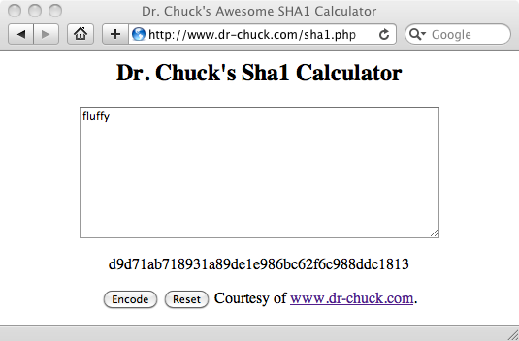
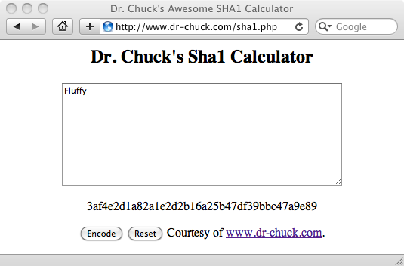
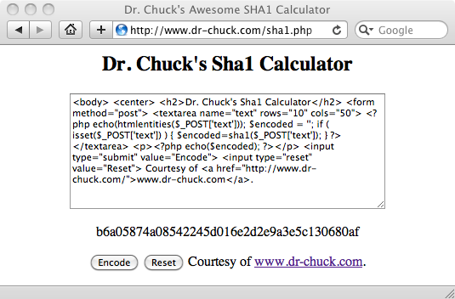
http://www.dr-chuck.com/sha1.php
http://en.wikipedia.org/wiki/SHA-1

Slide 29
Hashes for Passwords
As a general rule, systems do not store your password in plain text their databases in case they 'lose' their data
When you set the password, they compute a hash and store the hash
When you try to log in they compute the hash of what you type as a password and if it matches what they have stored - they let you in.
This is why a respectable system will never send your PW to you - they can only reset it!

Slide 30
Setting a new password
Store the 'hashed password' in the database.
SHA-1
fluffy
d9d71ab718931a89de1e986bc62f6c988ddc1813
Log in attempt
SHA-1
pony
2629fb6d2384da89796a4811ef6db5f2ac657bab
SHA-1
fluffy
d9d71ab718931a89de1e986bc62f6c988ddc1813
Match
http://www.dr-chuck.com/sha1.php

Slide 31
Digital Signatures
Message Integrity

Slide 32
Message Integrity
When you get a message from someone, did that message really come from who you think it came from?
Was the message altered while in transit or is the copy you received the same as the copy that was sent?

Slide 33
You
"Eat More Ovaltine
-- Annie"
Insecure Medium
How might we be very sure this message really came from Annie and it was not altered enroute?

Slide 34
Simple Message Signing
Shared secret transported securely 'out of band'
Before sending the message, concatenate the secret to the message
Compute the SHA digest of the message+secret
Send message + digest across insecure transport

Slide 35
Receiving a Signed Message
Receive message + digest from insecure transport
Remove digest and add secret
Compute SHA digest for message + secret
Compare the computed digest to the received digest

Slide 36
Eat More Ovaltine
SHA-1
Eat More OvaltineSanta
a79540
Eat More Ovaltinea79540
Eat More Ovaltinea79540
a79540
Eat More Ovaltine
SHA-1
Match! :)
Eat More OvaltineSanta
a79540
http://www.dr-chuck.com/sha1.php

Slide 37
Eat More Ovaltine
SHA-1
Eat More OvaltineSanta
a79540
Eat More Ovaltinea79540
Eat Less Ovaltinea79540
a79540
Eat Less Ovaltine
NO MATCH!!
SHA-1
Eat Less OvaltineSanta
109a15
http://www.dr-chuck.com/sha1.php

Slide 38
Eat More Ovaltinea79540
a79540
Eat More Ovaltine
SHA-1
Match! :)
Eat More OvaltineSanta
a79540
Free Cookies84d211
Which of these is real and which is fake?
Free Candy26497c
http://www.dr-chuck.com/sha1.php

Slide 39

Eat More Ovaltinea79540
a79540
Eat More Ovaltine
SHA-1
Match! :)
Eat More OvaltineSanta
a79540
Free Cookies84d211
Free CookiesSanta
c14d5d
X
Free Candy26497c
Free CandySanta
26497c
http://www.dr-chuck.com/sha1.php

Slide 40
Security for TCP
http://en.wikipedia.org/wiki/Secure_Sockets_Layer

Slide 41
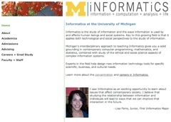
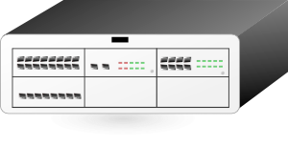


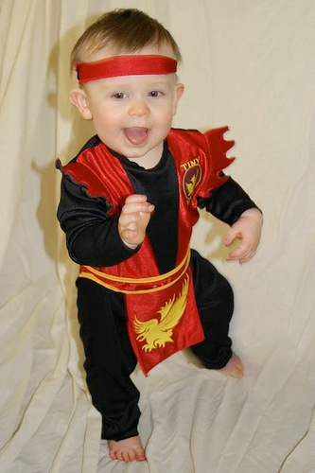
Packet
Sniffing
Clipart: http://www.clker.com/search/networksym/1
Photo CC BY: karindalziel (flickr)
http://creativecommons.org/licenses/by/2.0/

Slide 42
Transport Layer Security (TLS)
Used to be called “Secure Sockets Layer” (SSL)
Can view it as an extra layer “between” TCP and the application layer
It is very difficult but not impossible to break this security - normal people do not have the necessary compute resources to break TLS
The IP and TCP are unaware whether data has been encrypted

Slide 43
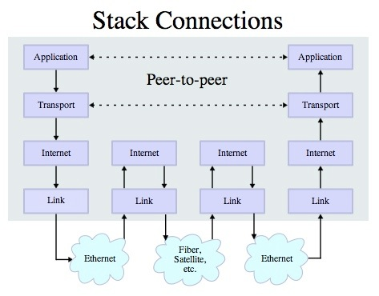
v

Slide 44

System to System Secure TCP/IP
Clipart: http://www.clker.com/search/networksym/1
Photo CC BY: karindalziel (flickr)
http://creativecommons.org/licenses/by/2.0/

Slide 45
Web-Scale Secret Management
Public Key Encryption

Slide 46
Secret Key Shortcomings
Every pair of people/systems needs a secret key
In the Internet, key distribution cannot be via the Internet because communications are insecure until you get the key!
For the Internet to work we need an approach where keys can cross the insecure Internet and be intercepted without compromising security

Slide 47
Establishing Keys at a Distance
Proposed by Whitfield Diffie and Martin Hellman in 1976
Public-key cryptosystems rely on two keys which are mathematically related to one another. Also called asymmetric-key cryptosystem.
One key is called the public key and is to be openly revealed to all interested parties.
The second key is called the private key and must be kept secret.
http://en.wikipedia.org/wiki/Public-key_cryptography

Slide 48
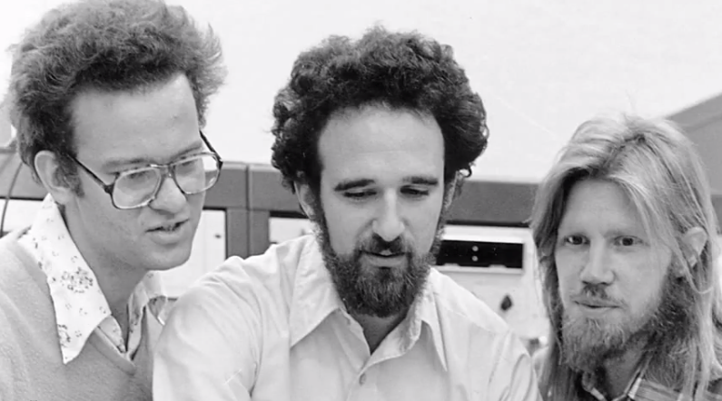
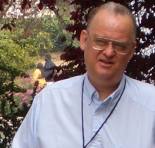
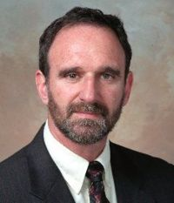

http://en.wikipedia.org/wiki/Ralph_Merkle
http://en.wikipedia.org/wiki/Martin_Hellman
http://en.wikipedia.org/wiki/Whitfield_Diffie
https://www.youtube.com/watch?v=ROCray7RTqM

Slide 49
Public Key
A message encrypted with one of the keys can only be decrypted with the other key.
It is computationally infeasible to recover one key from the other
Public-key cryptosystems solve the problem of secure key distribution because the public key can be openly revealed to anyone without weakening the cryptosystem.

Slide 50
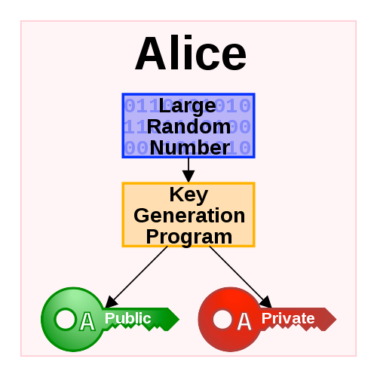
Generating Public/Private Pairs
Choose two large* random prime numbers
Multiply them
Compute public and private keys from that very large number
* The definition of "large" keeps getting bigger as computers get faster

Slide 51
Public Key Math (light)
Some functions are easy in “one direction”, but in the other, not so much!
Example: What are the factors of 55,124,159?

Slide 52
Public Key Math (light)
What are the factors of 55,124,159 (a nearly prime number)
What do you multiply 7919 by to get 55,124,159?
If you know that one of the factors is 7919, it’s also easy to find 6961!
US Patent 4,200,700 (Sep 6, 1977)

Slide 53
RSA Encryption
Implementation of secure channel based on public / private keys
Ron Rivest, Adi Shamir and Leonard Adleman
US Patent 4,405,829 (Dec 14, 1977)
http://people.csail.mit.edu/rivest/photos/Len-Adi-Ron.jpg

Slide 54
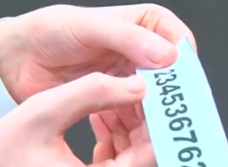
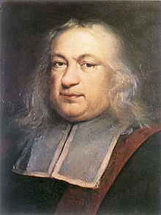
RSA Math (Light)
Prime numbers: 3 * 11 = 33
Public key: (33,7) (7 is computed from 3 and 11)
Private key: 3
Encrypt the letter f=6 (6**7) % 33 = 30 (sent)
Decrypt received text: (30**3) % 33 = 6 (f)
http://www.youtube.com/watch?v=M7kEpw1tn50
http://en.wikipedia.org/wiki/Fermat's_little_theorem
http://sergematovic.tripod.com/rsa1.html

Slide 55
You
Amazon.com
Plaintext:
"Visa928"
Message Might be Intercepted

Slide 56
You
Amazon.com
Plaintext:
"Visa928"
Message Might be Intercepted
Public Key
Private Key

Slide 57
You
Amazon.com
Plaintext:
"Visa928"
Message Might be Intercepted
Plaintext:
"Visa928"
Private Key
Encrypt
Public Key
Decrypt
CipherText:
"ablghyuip"
CipherText:
"ablghyuip"
Message Might be Intercepted

Slide 58
You
Amazon.com
Plaintext:
"Visa928"
Message Might be Intercepted
Plaintext:
"Visa928"
Private Key
Encrypt
Public Key
Decrypt
CipherText:
"ablghyuip"
CipherText:
"ablghyuip"
Message Might be Intercepted

Slide 59
Certificate Authorities
Integrity

Slide 60
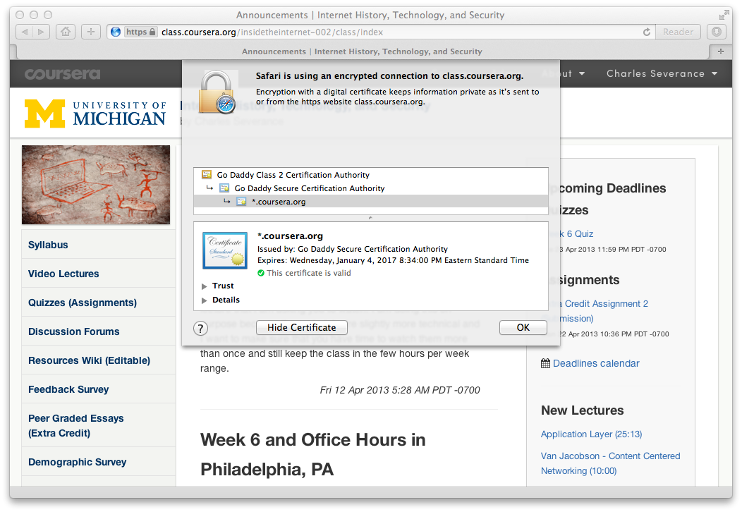
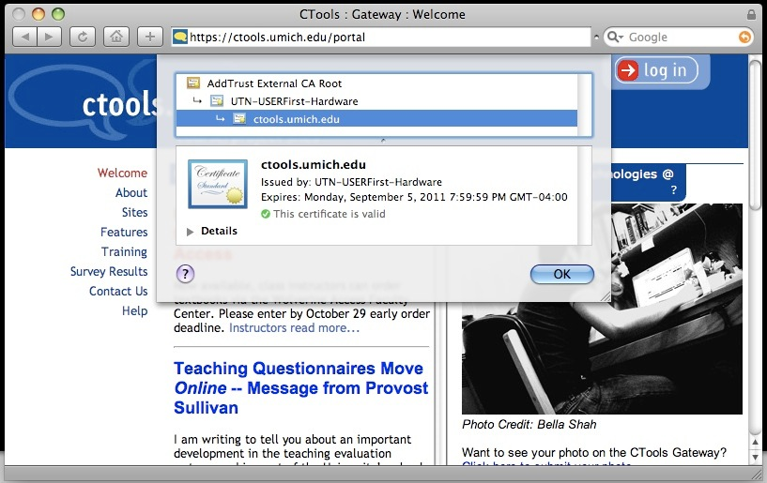

Slide 61
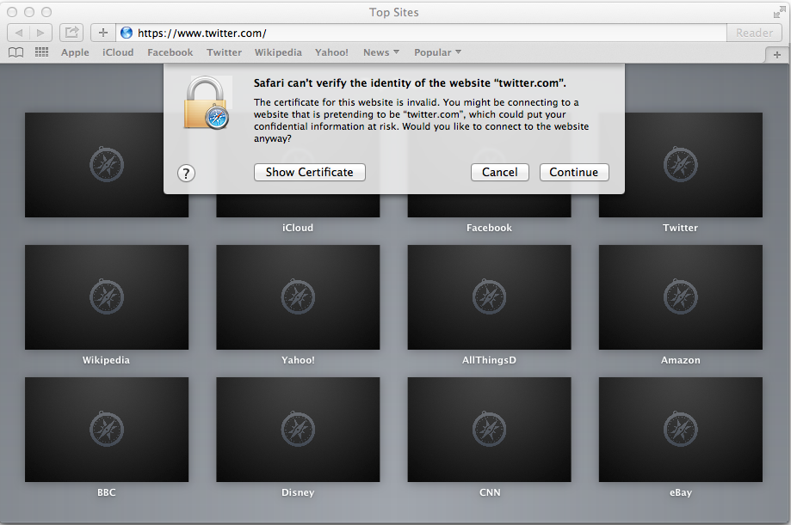

Slide 62
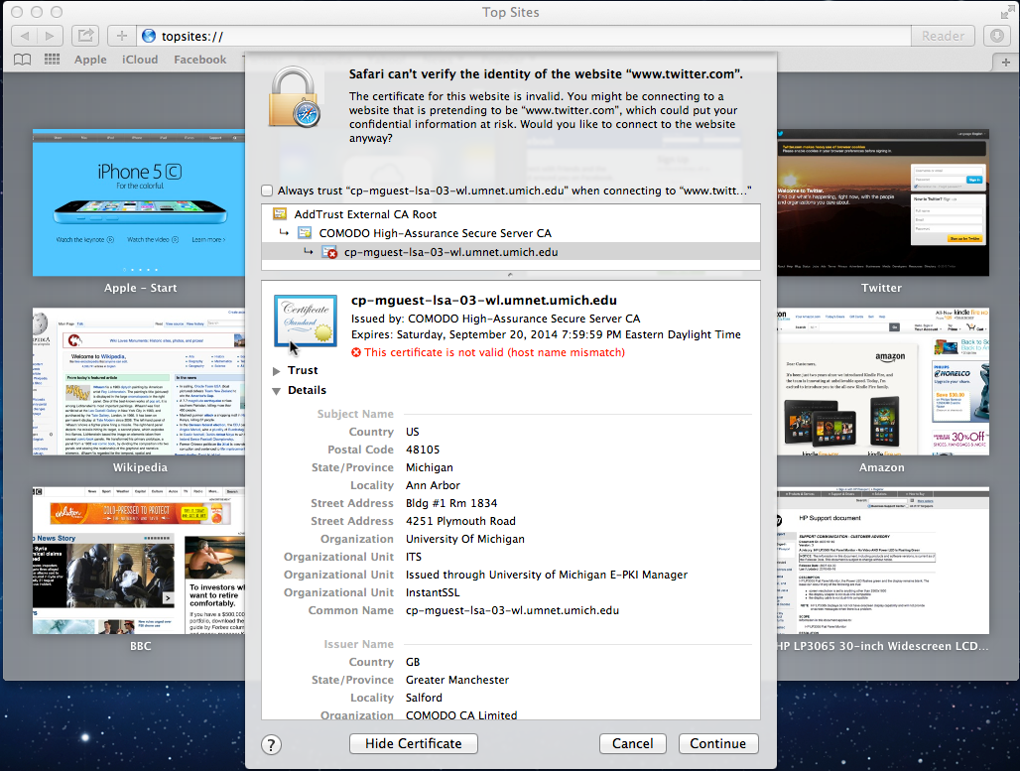

Slide 63
Public-Key Issues
Public-key cryptosystems have the problem of securely associating a public key with an individual
I am about to type in my credit card and send it - am I being Phished?
The remote server sent me a public key.
Should I use it? Is this really Amazon's public key?
http://en.wikipedia.org/wiki/Phishing

Slide 64
Digital Certificates
In cryptography, a public key certificate (also known as a digital certificate or identity certificate) is an electronic document which uses a digital signature to bind a public key with an identity — information such as the name of a person or an organization, their address, and so forth. The certificate can be used to verify that a public key belongs to an individual.
http://en.wikipedia.org/wiki/Public_key_certificate

Slide 65
Certificate Authority (CA)
A certificate authority is an entity that issues digital certificates. The digital certificate certifies the ownership of a public key by the named subject of the certificate. A CA is a trusted third party that is trusted by both the owner of the certificate and the party relying upon the certificate.
Text
http://en.wikipedia.org/wiki/Certificate_authority

Slide 66
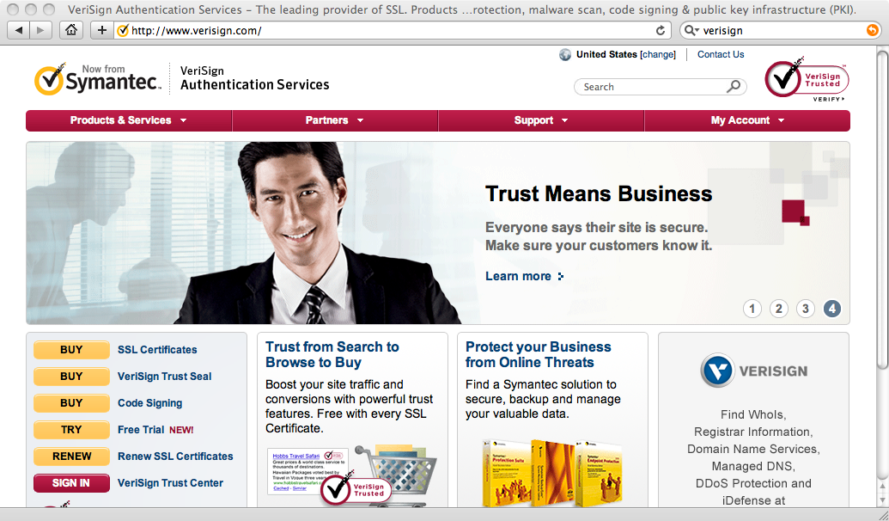

Slide 67
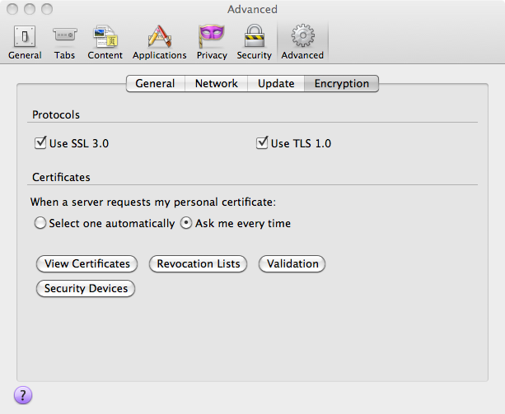
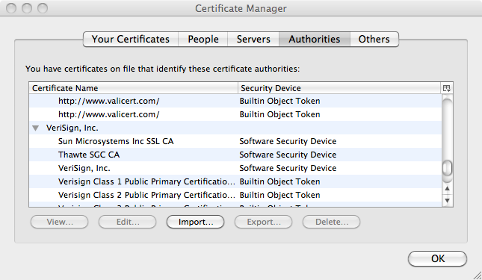
Your browser comes with certificates/public keys from some certificate authorities built in. Like Verisign.

Slide 68
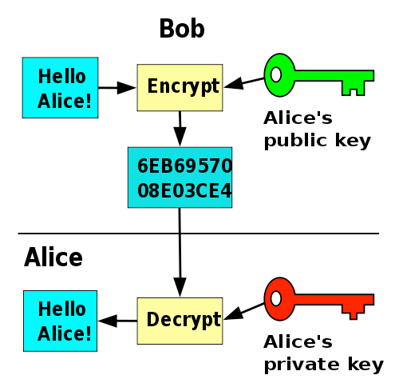
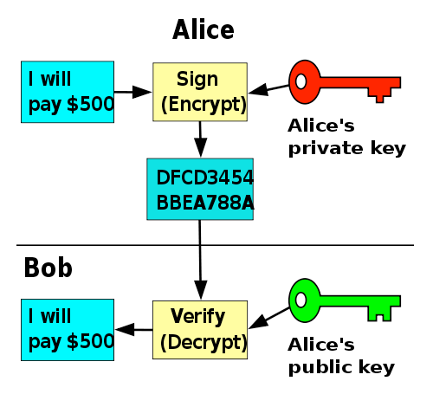
Public/Private Keys for Signing
http://en.wikipedia.org/wiki/Public-key_cryptography

Slide 69
How Amazon gets a public key signed by Verisign
Verisign Private Key
Verisign
Verisign Public Key
Amazon
Your Laptop

Slide 70
Verisign Private Key
Verisign
Cert: Amazon
-- Verisign
Amazon Public Key
Amazon Public Key
Amazon Private Key
Verisign Public Key
Amazon
Your Laptop

Slide 71
Verisign Private Key
Verisign
Amazon Public Key
Cert: Amazon
-- Verisign
Amazon Public Key
Amazon Private Key
Verisign Public Key
Amazon
Your Laptop

Slide 72
Verisign Private Key
Verisign
Amazon Public Key
Amazon Private Key
Amazon Public Key
Cert: Amazon
-- Verisign
Verisign Public Key
Amazon
Your Laptop

Slide 73
Verisign Private Key
Verisign
Amazon Public Key
Amazon Private Key
Amazon Public Key
Amazon Public Key
Cert: Amazon
-- Verisign
Cert: Amazon
-- Verisign
Verisign Public Key
Amazon
Your Laptop

Slide 74
Verisign Private Key
Verisign
Amazon Public Key
Cert: Amazon
-- Verisign
Amazon Private Key
Amazon Public Key
Cert: Amazon
-- Verisign
Verisign Public Key
Amazon
Your Laptop

Slide 75
Certificate Authority (CA)
A certificate authority is an entity that issues digital certificates. The digital certificate certifies the ownership of a public key by the named subject of the certificate. A CA is a trusted third party that is trusted by both the owner of the certificate and the party relying upon the certificate.
Text
http://en.wikipedia.org/wiki/Certificate_authority

Slide 76
v

Slide 77
Summary
Message Confidentiality / Message Integrity
Encrypting / Decrypting
Message digests and message signing
Shared Secret Key / Public Private Key
Gambling with Secrets: http://www.youtube.com/playlist?list=PLB4D701646DAF0817

Slide 78
Reuse of these materials
I intend for these materials to be reusable as open educational resources for those who would do so in a responsible manner
Please contact me if you are interested in reusing or remixing these materials in your own teaching or educational context

